Slide 1


Digital PR Playbook
The Convergence
of Search, Social,
and Your Website
Zach Hoffman
President & CEO
Zach.Hoffman@Exults.com

Slide 2
Presentation Overview
What is Digital PR?
Who needs Digital PR?
Why do you need Digital PR?
Digital PR Strategies
Reporting Success

Slide 3



What is Digital PR?
Controlling brand messaging and online presence in search results and on social media platforms.

Slide 4


Who Needs Digital PR?
Individuals
Companies
Individuals’ reputations need to be controlled in digital results. If you are an executive, celebrity, or just a normal person with little true representation, you need Digital PR.
Companies may be unknowingly letting the digital wave control their reputation and brand online. Digital Public Relations can assist your company in controlling your digital assets.

Slide 5


Who Needs Digital PR?
Agency Partnerships
Emerging Brands
Traditional public relations firms can leverage a partner well versed in digital strategies to solidify the online presence of clients.
Consumers rely on search engines as their first source of information. New brands need Digital PR to establish their footprint in the SERPs.

Slide 6
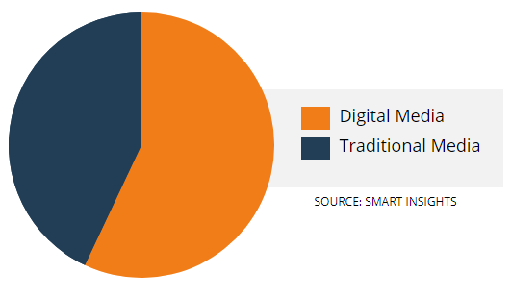
Everyone Needs Digital PR
On average, consumers are spending a third of the time on traditional media that they’re spending on digital media
{digital media consumption is on the rise}
https://www.entrepreneur.com/article/279873

Slide 7
Why do you need Digital PR?
94% of B2B buyers research online for purchase decisions
88% of consumers trust online reviews as much as personal recommendations
91% of brands use 2 or more social media channels
Google processes an average of 40k search queries per second
15% of those searches have never been conducted before
https://hostingfacts.com/internet-facts-stats/
https://www.brandwatch.com/blog/amazing-social-media-statistics-and-facts/
https://biznology.com/2016/09/50-facts-online-consumer-behavior-not-ignore/

Slide 8
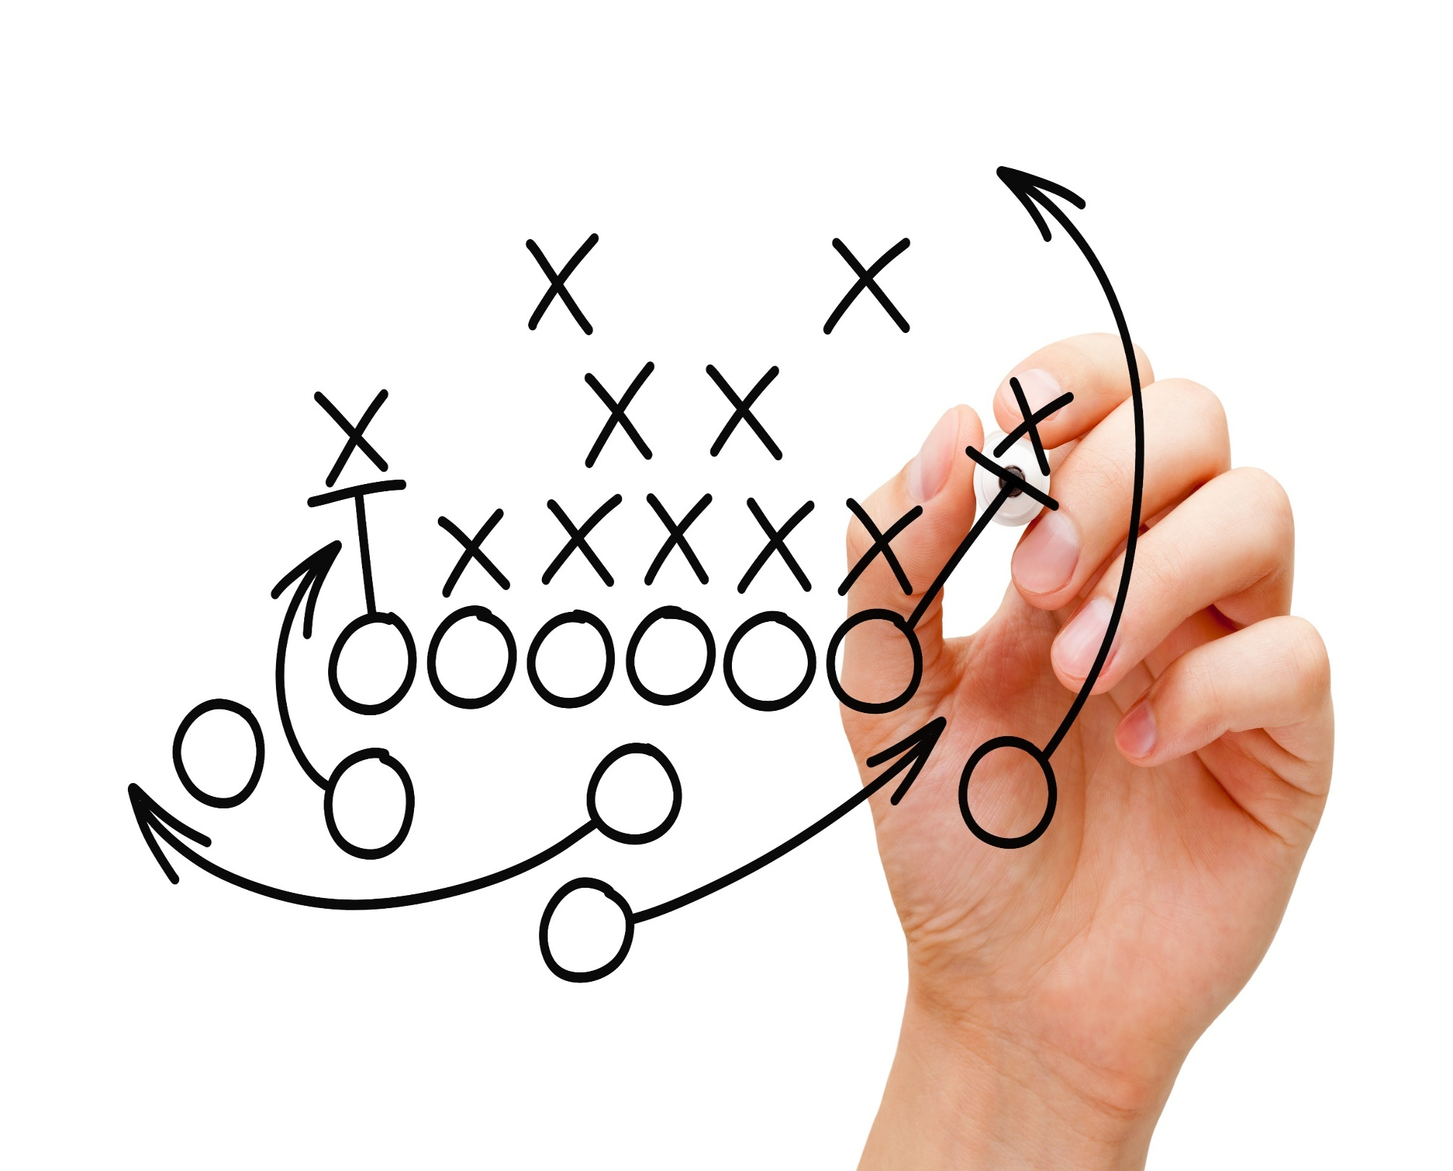
Strategies
Your Playbook for Success
Responsive, contextually rich website
Comprehensive onsite optimization
Active Social Media profiles
Ongoing high DA backlink building
Microsites with high-value domains

Slide 9

Strategies
Your Playbook for Success
Responsive, contextually rich website

Slide 10



Responsive Website Design
A brand website need to meet Google’s current development standards
This is Critical to obtaining effective search engine results that depict the most accurate representation of your brand online
Your checklist should include:

Slide 11
Responsive framework that scales appropriately for most common screen sizes
Responsive Website Design
Yes, it’s a lot of work. And yes, it’s necessary.
TIP: Use BrowserStack to simulate common devices

Slide 12
Easy to use and interact with on mobile, tablet, and desktop devices
Responsive Website Design
Using a mobile site as a desktop site creates a subpar user experience- and vise versa
Dedicated viewports work best
TIP: Lose those hamburger menus on desktop sites!

Slide 13
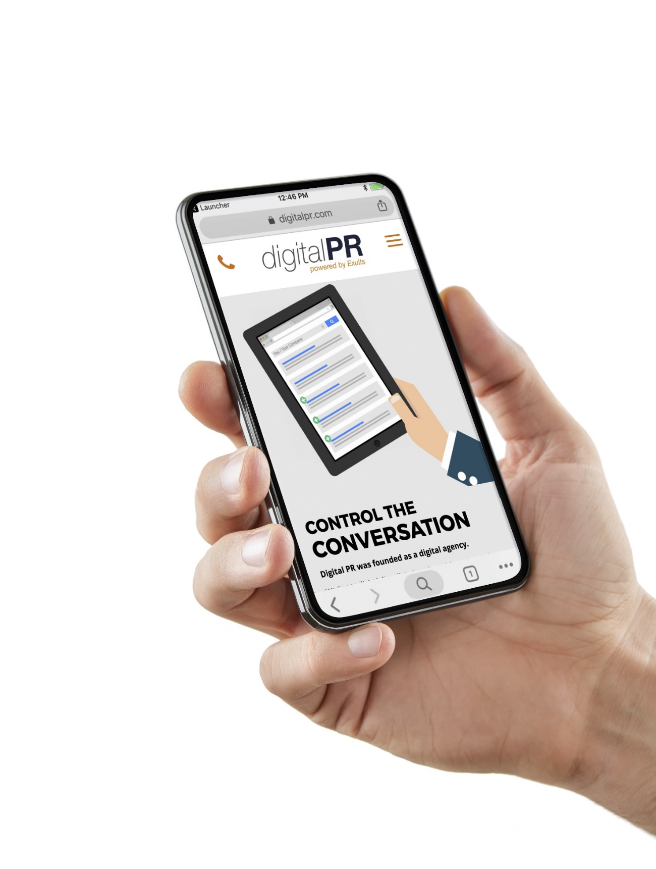
Compatible with a variety of mobile browsers
Responsive Website Design
Dig into your Analytics data to understand
the devices your customers are using so you
know where to start
TIP: Find your data in Audience→Technology→Browser & OS

Slide 14

Loads quickly over cellular data
Responsive Website Design
Google’s Pagespeed score is generated using a Moto G4 on a mobile network
TIP: Beyond Google Site Speed Tool PageSpeed Insights score utilize GTMetrix.com for grading and troubleshooting

Slide 15

Checklist:
Responsive Website Design
Responsive framework that scales appropriately for most common screen sizes
Easy to use and interact with on mobile, tablet, and desktop devices
Compatible with a variety of mobile browsers
Loads quickly over cellular data
TIP: Download this checklist at DigitalPR.com/SMX-West

Slide 16
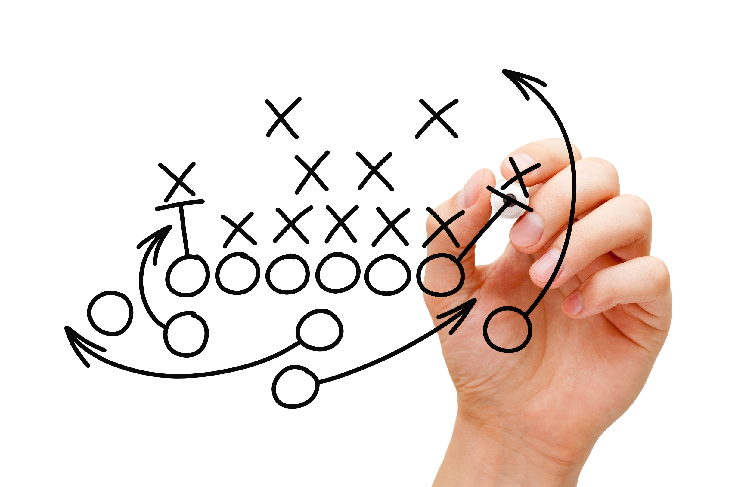
Strategies
Your Playbook for Success
Responsive, contextually rich website
Comprehensive onsite optimization

Slide 17
Comprehensive Onsite Optimization
By following SEO best practices, your
website has a better chance of ranking
when potential customers are searching
for you online.
What do you need for an optimized website?
Your checklist should include:

Slide 18

Start with keyword research
Comprehensive Onsite Optimization
  Start with keyword research to understand what
  users are actually searching
  Data will guide you to the best keywords to build meta data, content development, page structure, and blog topics to capture these searches
TIP: Use SEMrush’s Keyword Magic Tool to research search volume for each keyword to determine focus and value

Slide 19
Optimized Meta Data
Comprehensive Onsite Optimization
  Identify key pages, restate the main idea in simple terms
  Avoid duplicating the first few lines of copy on the page as your description
TIP: Over optimization is possible- keep it simple.

Slide 20
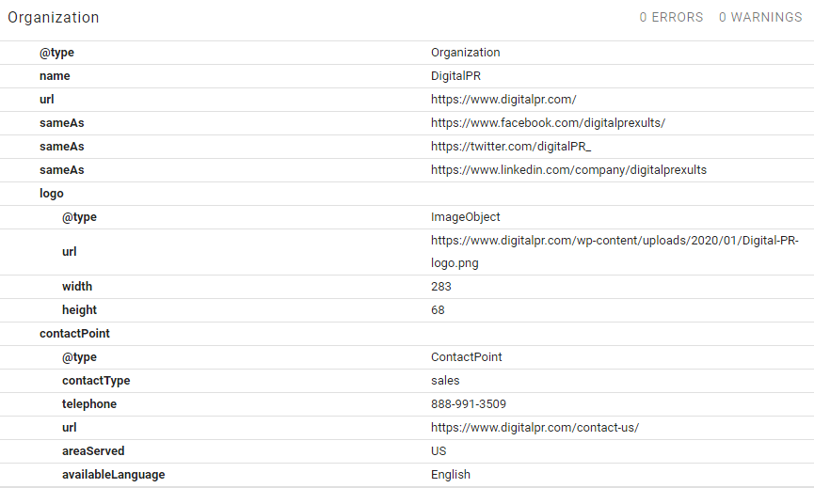
Schematic Markup
Comprehensive Onsite Optimization
  Schema powers rich snippets on the
  Search Engine Results page and
  maximizes crawl budget
  Find the Schemas relevant to your industry at Schema.org
TIP: Use Google’s Structed Data Testing Tool to check your code

Slide 21

Technical Audits
Comprehensive Onsite Optimization
  User experience matters!
  Issues like broken links, and widowed or
  404 pages are visible to Google and will impact
  your quality ratings
TIP: Use WebCEO.com to sniff out hidden technical issues.

Slide 22
Cache Cleanup
Comprehensive Onsite Optimization
  Fix “Cache Bloat”
  Create evergreen content, remove outdated blogs, and eliminate duplicate pages
  Maximizing crawl budget
TIP: Use “Site:www.website.com” command to see Google’s Cache of your site by searching the above on Google

Slide 23
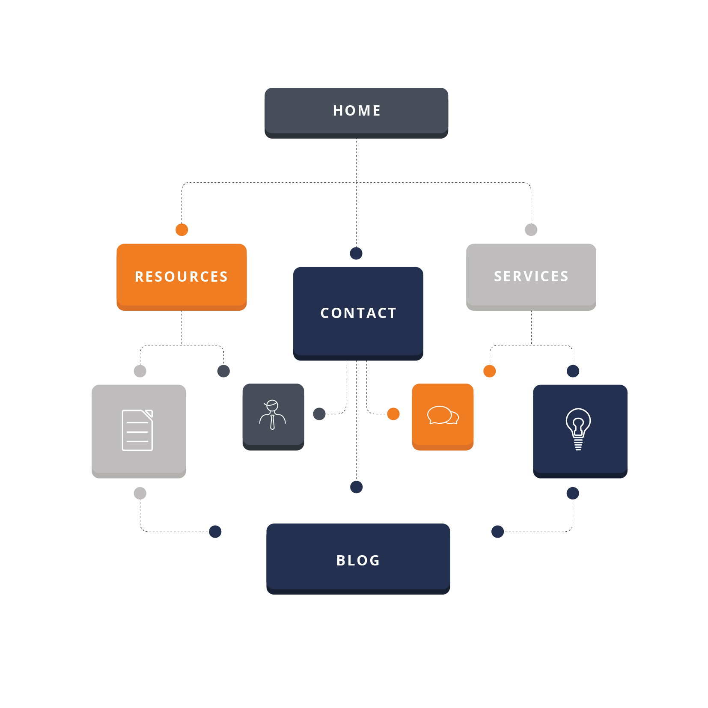
Website Structure
Comprehensive Onsite Optimization
  A website should resemble a
  well-organized outline or book
  Core services as the main list-level
  Related topics should be grouped into the
  appropriate folders
TIP: Consider keyword research and UX when determining website hierarchy (Believe it or not, users don’t always search how industry experts think they do!)

Slide 24
Checklist:
Comprehensive Onsite Optimization
Start with keyword research
Optimized Meta Data
Schematic Markup
Technical Audits
Cache Cleanup
Website Structure
TIP: Download this checklist at DigitalPR.com/SMX-West

Slide 25
Strategies
Your Playbook for Success
Responsive, contextually rich website
Comprehensive onsite optimization
Active Social Media profiles

Slide 26

Active Social Media Profiles
Social media enables brands to have a two-way conversation with customers. If social media accounts are not claimed or managed, your audience can control your brand reputation.
Your checklist should include:

Slide 27
Profiles set up on all major platforms relevant to your industry
Active Social Media Profiles
  Identify the social media platforms that will work best for the type of content you have to share
  Links and content? Try Facebook or LinkedIn
  Images? Try Instagram or Pinterest
TIP: Use UTM URLs to track referral traffic from social platforms

Slide 28

Accurate company information in all profiles
Active Social Media Profiles
  Each social media profile counts as a high-quality, relevant backlink to your domain and an added asset for SERPs
  This will contribute to NAP (Name, Address, Phone Number) consistency- so make sure your formatting is consistent
TIP: Make sure your cover images fit properly on mobile devices!

Slide 29
Curated feed with interesting and engaging content
Active Social Media Profiles
  Customers are choosing to follow you on social media
  Make it worth their while with valuable content that’s not just self-promotional
  Remember to also make it FUN and engaging
TIP: Vary content by platform so users follow you everywhere.

Slide 30

Respond to messages and comments
Active Social Media Profiles
  Main purpose of social media is to engage
  You may encounter reviews, comments, or
  posts that don’t cast your brand in the best light
  Don’t let that stop you from engaging
TIP: Plan out responses to negative comments in advance.

Slide 31
Checklist:
Active Social Media Profiles
Profiles set up on all major platforms relevant to your industry
Accurate company information in all profiles
Curated feed with interesting and engaging content
Respond to messages and comments
TIP: Download this checklist at DigitalPR.com/SMX-West

Slide 32

Strategies
Your Playbook for Success
Responsive, contextually rich website
Comprehensive onsite optimization
Active Social Media profiles
Ongoing high DA backlink building

Slide 33
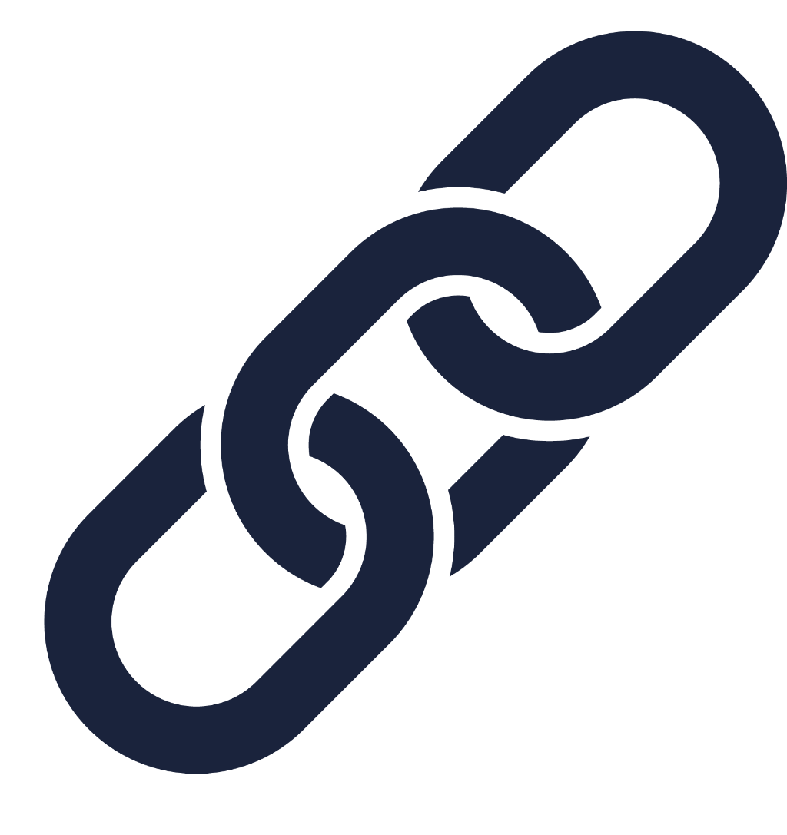
Ongoing backLink building
  Backlinks are a cornerstone of Organic SEO
  They help boost the results of Digital PR campaigns and assets
  However, not all backlinks are created equal
Your checklist should include:

Slide 34

Digital Press Release Syndication
Ongoing backLink building
  A well-written, timely and topical press release can result in hundreds of backlinks and brand mentions on credible platforms
  Don’t miss out on this easy win
TIP: Focus on growth, development, or timely content for maximum pick-up

Slide 35

Backlink acquisition from high DA sources
Ongoing backLink building
  Not all backlinks are created equal
  Each backlink you acquire is like a vote- make sure you want those votes you’re getting
  Diversify your link profile across all assets you want to rank, including social profiles
TIP: Always select responsive websites with SSL certificates for backlinks

Slide 36
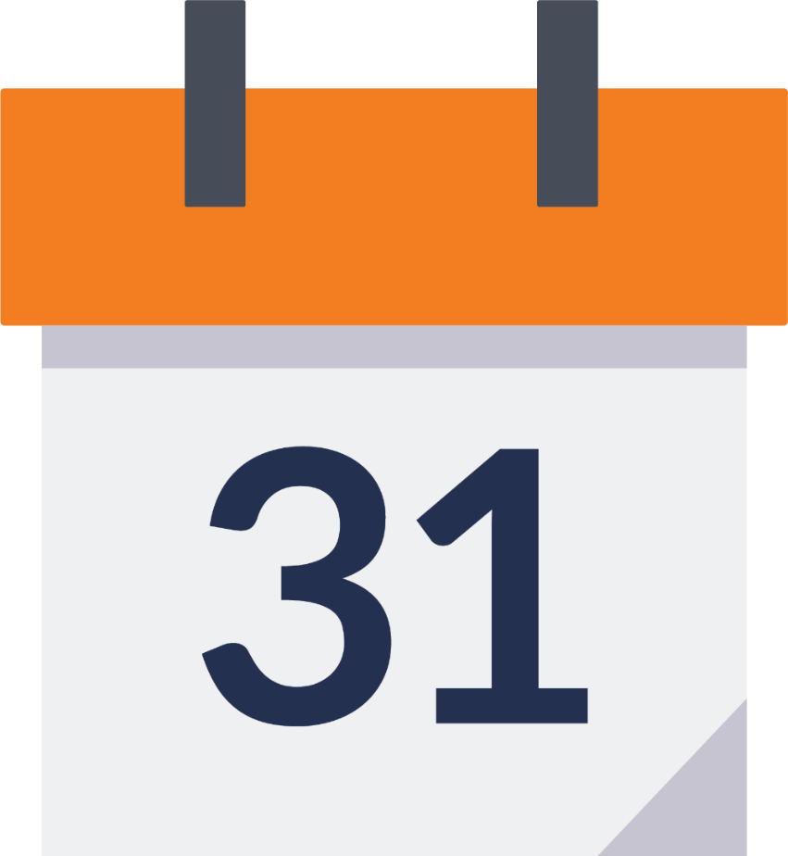
Natural acquisition schedule
Ongoing backLink building
  When you’re publishing high-quality content, backlinks accumulate over time
  Focus on acquiring 1 to 2 high DA backlinks each month at a minimum
  Strategy depends on the strength and authority you have already created, some properties can get 10 to 20 per month and look natural
TIP: It’s not a race! Choose wisely and focus on quality.

Slide 37
Checklist:
Ongoing backLink building
Digital Press Release syndication
Backlink acquisition from high DA sources
Natural acquisition schedule
Ongoing high DA backlink building
TIP: Download this checklist at DigitalPR.com/SMX-West

Slide 38

Strategies
Your Playbook for Success
Responsive, contextually rich website
Comprehensive onsite optimization
Active Social Media profiles
Ongoing high DA backlink building
Microsites with high-value domains

Slide 39
Microsites with high-value domains
To achieve a diverse SERP it’s important to have more than enough branded, controlled assets to dominate the first page of results for searches that impact your business
Your checklist should include:

Slide 40
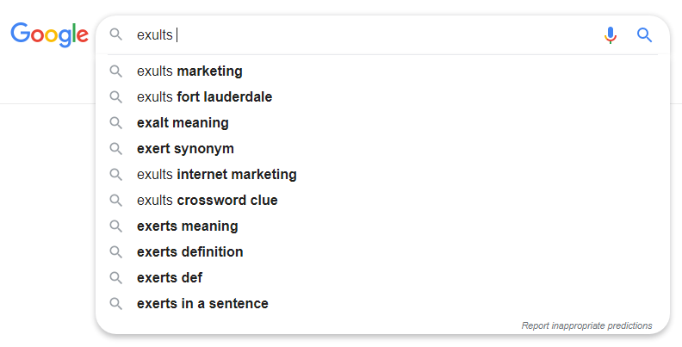
Think: related searches
Microsites with high-value domains
  Search for your branded terms online and check the “related searches” at the bottom of the SERP. What do you see?
  The results should help make your domain name selection
TIP: Type your brand name into the Google Search bar and hit “space” to see suggested searches for your brand

Slide 41

Focus on keywords with natural content potential
Microsites with high-value domains
  Your new microsites will need content regularly
  Select topics that will have natural content opportunities on an ongoing basis
TIP: Topics like careers, news, community involvement or coupons will create easy relationships to nurture

Slide 42

Keep your microsites active and updated
Microsites with high-value domains
Updated content on an ongoing basis- which makes domain selection even more important
  New events, involvement, or career opportunities
TIP: Think about industry publications you follow- what do they write about?

Slide 43
Checklist:
Microsites with high-value domains
Think: related searches
Focus on keywords with natural content potential
Keep your microsites active and updated
TIP: Download this checklist at DigitalPR.com/SMX-West

Slide 44
Strategies
Your Playbook for Success
Responsive, contextually rich website
Comprehensive onsite optimization
Active Social Media profiles
Ongoing high DA backlink building
Microsites with high-value domains

Slide 45
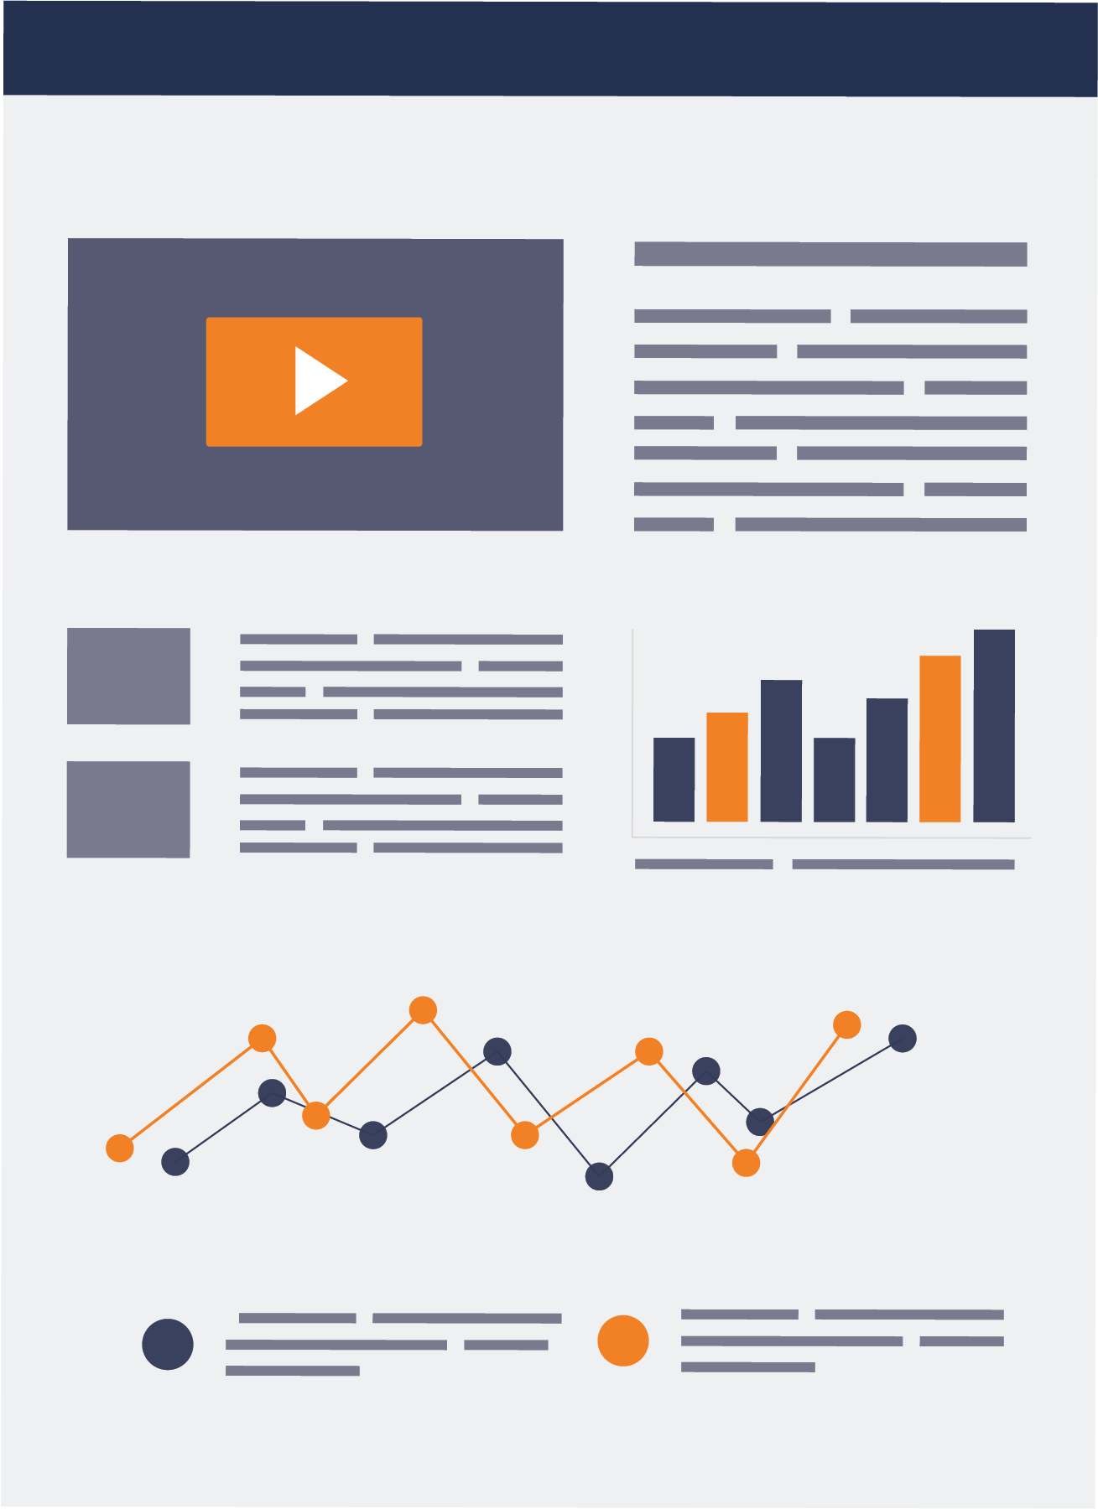
Reporting success
If you’ve cultivated a squeaky clean
SERP for your brand, but don’t know
how to report on it- does it matter?
Here’s what to focus on to prove your wins:

Slide 46

Reporting success
Reporting on Your Success
Amount of owned assets on the first page of results
Accurate results for key terms- branded & non-branded
Audit search results via VPN (ex: Private Access Network)

Slide 47

Amount of owned assets on the first page of results
Reporting success
  Your brand’s core website, microsites and
  social profiles, you will control all content on
  Ancillary sites like directory websites, and
  positive news should be a part of the concentration of websites
TIP: Use rank tracking tools to keep track of your assets

Slide 48

Accurate results for branded & non-branded key terms
Reporting success
  Don’t count your clean SERP as a win if you’re
  only monitoring branded key terms
  Ask yourself what potential customers search
  when looking for your services
TIP: Use search query data to identify high impression queries to track

Slide 49

Audit search results using a VPN
Reporting success
  Everyone using Google is seeing different search results based on their own behavior
  Strip out bias and location influence with a VPN
TIP: Search “pizza near me” to verify your location

Slide 50
Checklist:
Reporting success
Amount of owned assets on the first page of results
Accurate results for key terms- branded & non-branded
Audit search results via VPN (ex: Private Access Network)
TIP: Download this checklist at DigitalPR.com/SMX

Slide 51
Presentation Overview
What is Digital PR?
Who needs Digital PR?
Why do you need Digital PR?
Digital PR Strategies
Reporting Success

Slide 52
Questions & Answers
Digital PR Playbook
The Convergence
of Search, Social,
and Your Website
Zach Hoffman
President & CEO
Zach.Hoffman@Exults.com

